Slide 1
BANK MANAGEMENT SYSTEM
Presented by
Name: Krishna Chaitanya Enrollment Number :EBEON1021459219

Slide 2
Abstract
In this project, we will learn how to create a mini-application for a banking system in Java. In this program we will add some basic features of a bank account like deposit ,withdrawal etc.
Initially, the program accepts the number of customers we need to add and then adds the customer and account details accordingly. Further, it displays the series of choices to operate over the accounts.
The series of Choices displayed are as follows:
Display all account details
Search by account number
Deposit the amount
Withdraw the amount
Exit

Slide 3
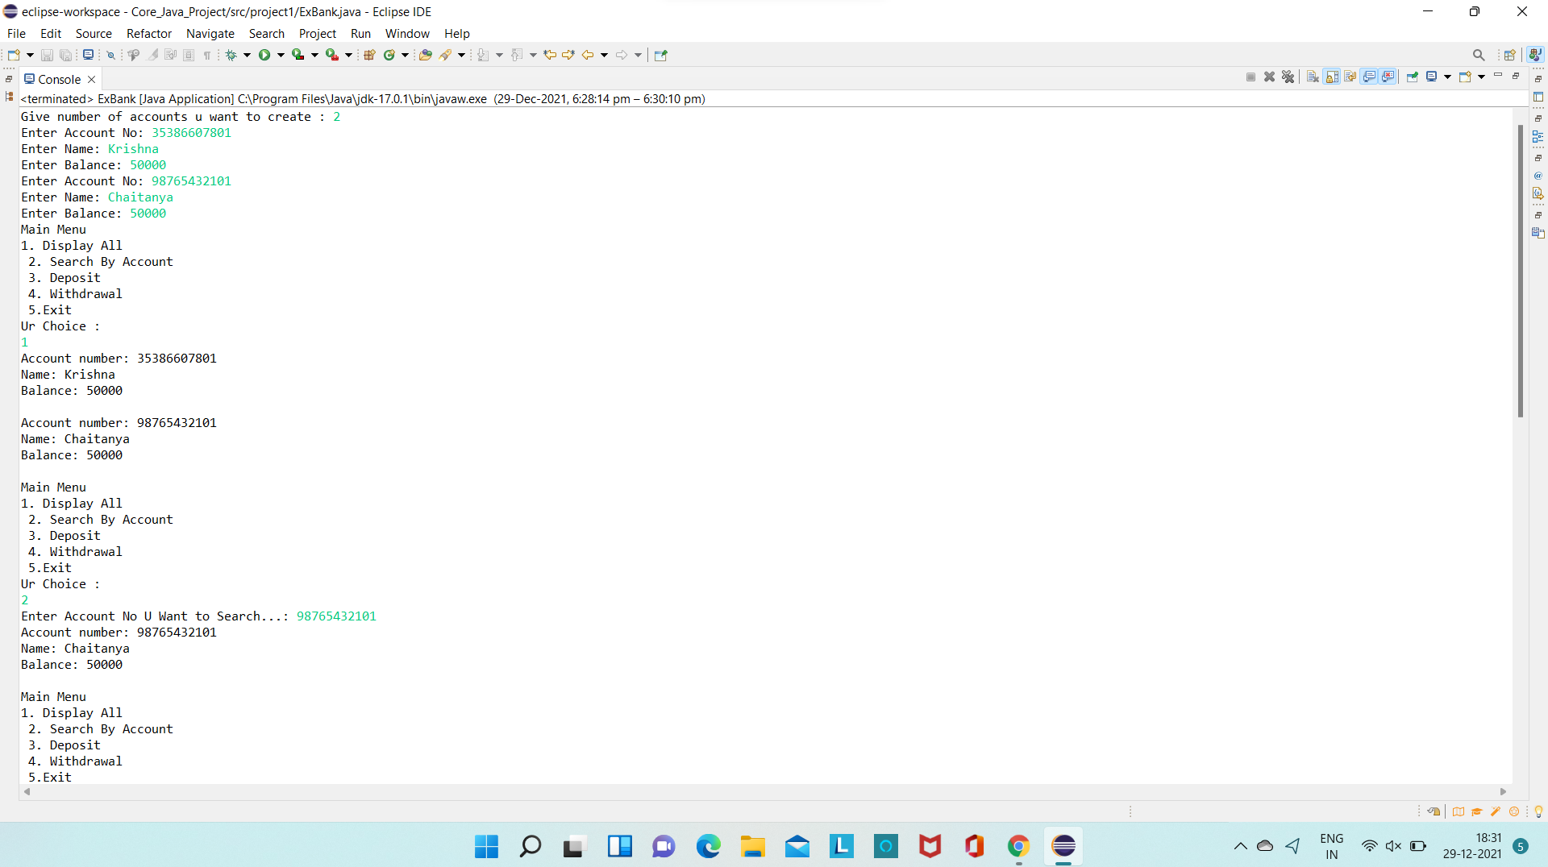
Output 1:

Slide 4
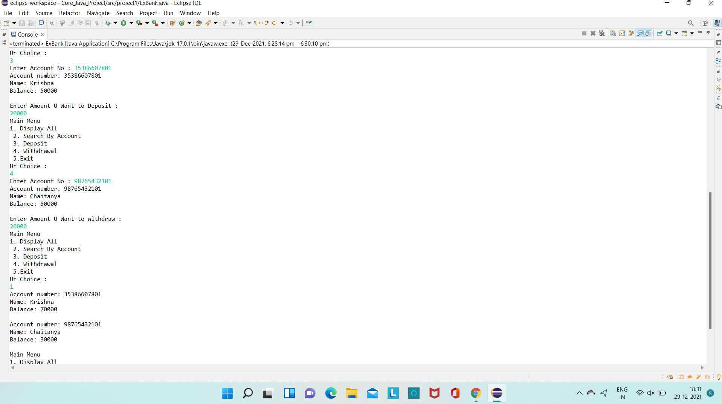
Output 2:

Slide 5
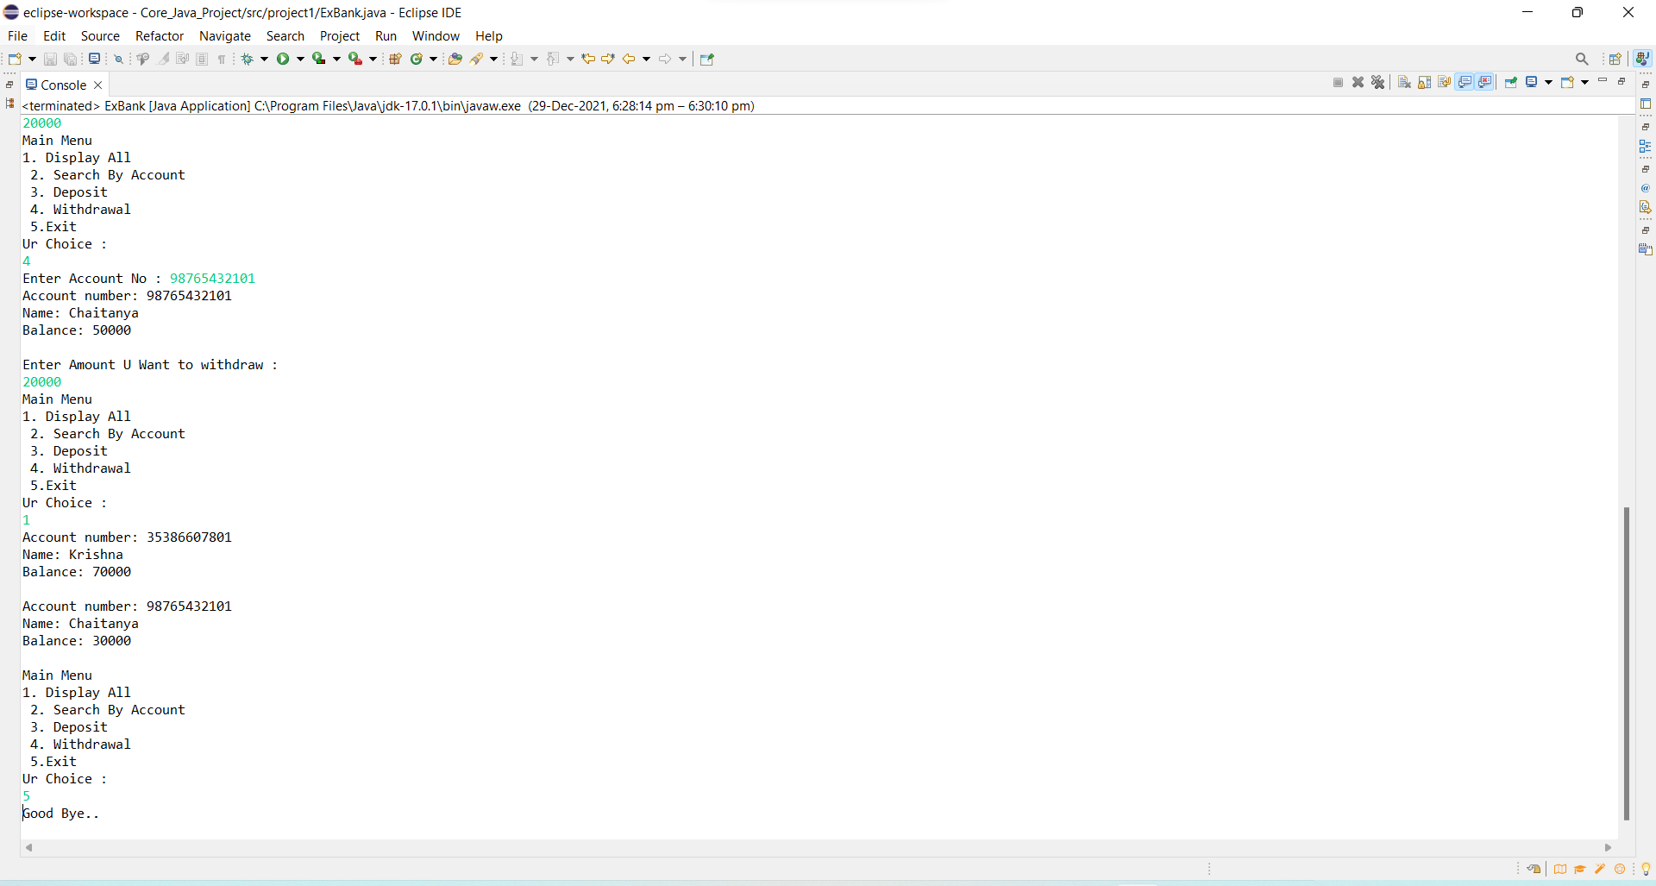
Output 3:

Slide 6
THANK YOU

